Slide 1
Merton Truck Company
Sessions 1 – 2
Accelerated General Management Program
2020 Session

Slide 2
Profits
Sales Manager:
 |  | Model 101 | Model 102
Revenue |  | $39,000 | $38,000
Costs |  | $36,000 | $33,000
 | Direct Materials | $24,000 | $20,000
 | Direct Labour | $4,000 | $4,500
 | Overhead (Total) | $12,205 | $11,430
Profits |  | –$1205 | $2070
How do you get this value?

Slide 3
Is there a problem with this?
Product mix: 1000 Model 101s, 1500 Model 102s
Product mix: 2500 Model 101s, 500 Model 102s
This part of the fixed overhead is not accounted for!
Loaded onto 101s
Loaded onto 102s
Fixed overhead for engine assembly
Fixed overhead allocated to 500 Model 101s
Fixed overhead allocated to 500 Model 102s

Slide 4
Contribution to Profits
Contribution per unit = Revenue per unit – Direct Costs per unit
Direct costs = Direct Materials + Direct Labour + Variable Overhead
(i.e., no fixed overhead component)
 |  | Model 101 | Model 102
Revenue |  | $39,000 | $38,000
Direct Costs |  | $36,000 | $33,000
 | Direct Materials | $24,000 | $20,000
 | Direct Labour | $4,000 | $4,500
 | Variable Overhead | $8,000 | $8,500
Contribution |  | $3000 | $5000

Slide 5






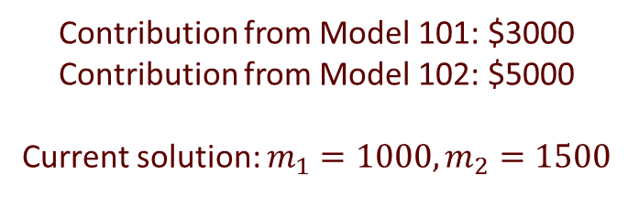
Question 1(a)
Contribution from Model 101: $3000 Contribution from Model 102: $5000
Current solution: $m_{1}=1000, m_{2}=1500$
If there is a better solution, it is not here!
$$m_{2}<1500$$
$$m_{2}=1500$$
$$m_{2}>1500$$
$$m_{1}<1000$$
$$m_{1}=1000$$
$$m_{1}>1000$$

Slide 6
In Search of a Better Solution
Contribution from Model 101: $3000 Contribution from Model 102: $5000
Current solution: $m_{1}=1000, m_{2}=1500$
If there is a better solution, it is not here!
$$m_{2}<1500$$
$$m_{2}=1500$$
$$m_{2}>1500$$
$$m_{1}<1000$$
$$m_{1}=1000$$
$$m_{1}>1000$$
?

Slide 7
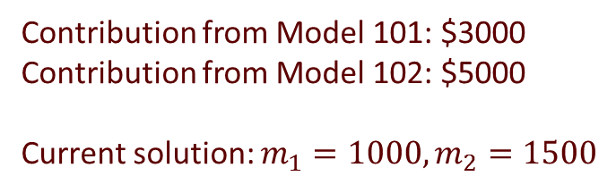



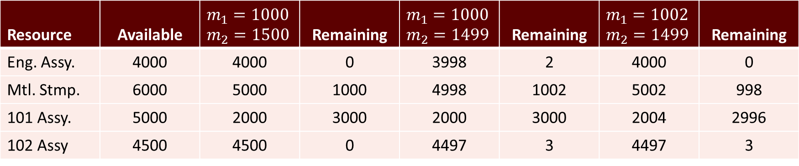
In Search of a Better Solution
Contribution from Model 101: $3000 Contribution from Model 102: $5000
Current solution: $m_{1}=1000, m_{2}=1500$
$$m_{2}<1500$$
$$m_{2}=1500$$
$$m_{2}>1500$$
$$m_{1}<1000$$
$$m_{1}=1000$$
$$m_{1}>1000$$
Resource | Available | $$m_{1}=1000 \\ m_{2}=1500$$ | Remaining | $$m_{1}=1000 \\ m_{2}=1499$$ | Remaining | $$m_{1}=1002 \\ m_{2}=1499$$ | Remaining
Eng. Assy. | 4000 | 4000 | 0 | 3998 | 2 | 4000 | 0
Mtl. Stmp. | 6000 | 5000 | 1000 | 4998 | 1002 | 5002 | 998
101 Assy. | 5000 | 2000 | 3000 | 2000 | 3000 | 2004 | 2996
102 Assy | 4500 | 4500 | 0 | 4497 | 3 | 4497 | 3
$10,500,000
$10,495,000
$10,501,000

Slide 8
In Search of a Better Solution
Contribution from Model 101: $3000 Contribution from Model 102: $5000
Current solution: $m_{1}=1000, m_{2}=1500$
$$m_{2}<1500$$
$$m_{2}=1500$$
$$m_{2}>1500$$
$$m_{1}<1000$$
$$m_{1}=1000$$
$$m_{1}>1000$$
Resource | Available | $$m_{1}=1000 \\ m_{2}=1500$$ | Remaining | $$m_{1}=1000 \\ m_{2}=1499$$ | Remaining | $$m_{1}=1002 \\ m_{2}=1499$$ | Remaining
Eng. Assy. | 4000 | 4000 | 0 | 3998 | 2 | 4000 | 0
Mtl. Stmp. | 6000 | 5000 | 1000 | 4998 | 1002 | 5002 | 998
101 Assy. | 5000 | 2000 | 3000 | 2000 | 3000 | 2004 | 2996
102 Assy | 4500 | 4500 | 0 | 4497 | 3 | 4497 | 3
STEP
NO CHANGE
USE 2 EXTRA HOURS
USE 4 EXTRA HOURS
USE 3 LESS HOURS
$10,500,000
INCREASE BY $1000
$10,501,000
$10,495,000

Slide 9
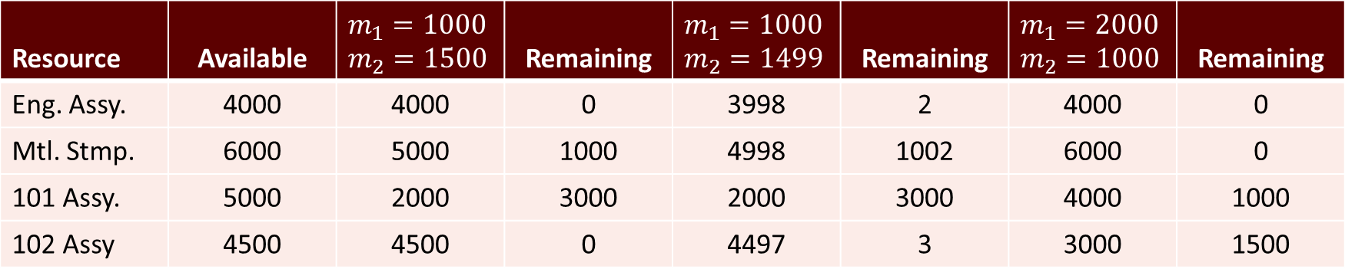
In Search of a Better Solution
Contribution from Model 101: $3000 Contribution from Model 102: $5000
Current solution: $m_{1}=1000, m_{2}=1500$
$$m_{2}<1500$$
$$m_{2}=1500$$
$$m_{2}>1500$$
$$m_{1}<1000$$
$$m_{1}=1000$$
$$m_{1}>1000$$
Resource | Available | $$m_{1}=1000 \\ m_{2}=1500$$ | Remaining | $$m_{1}=1000 \\ m_{2}=1499$$ | Remaining | $$m_{1}=2000 \\ m_{2}=1000$$ | Remaining
Eng. Assy. | 4000 | 4000 | 0 | 3998 | 2 | 4000 | 0
Mtl. Stmp. | 6000 | 5000 | 1000 | 4998 | 1002 | 6000 | 0
101 Assy. | 5000 | 2000 | 3000 | 2000 | 3000 | 4000 | 1000
102 Assy | 4500 | 4500 | 0 | 4497 | 3 | 3000 | 1500
500 steps
After 500 steps
$10,500,000
$10,495,000
$11,000,000

Slide 10
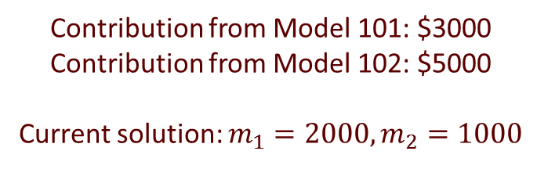






In Search of a Better Solution
Contribution from Model 101: $3000 Contribution from Model 102: $5000
Current solution: $m_{1}=2000, m_{2}=1000$
$$m_{2}<1000$$
$$m_{2}=1000$$
$$m_{2}>1000$$
$$m_{1}<2000$$
$$m_{1}=2000$$
$$m_{1}>2000$$
?

Slide 11



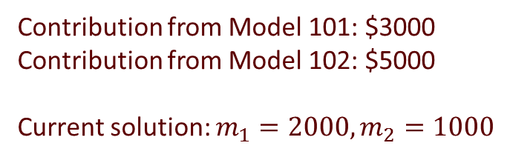



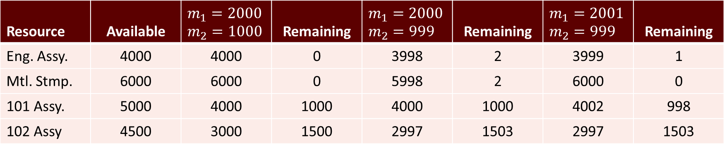
In Search of a Better Solution
Contribution from Model 101: $3000 Contribution from Model 102: $5000
Current solution: $m_{1}=2000, m_{2}=1000$
$$m_{2}<1000$$
$$m_{2}=1000$$
$$m_{2}>1000$$
$$m_{1}<2000$$
$$m_{1}=2000$$
$$m_{1}>2000$$
Resource | Available | $$m_{1}=2000 \\ m_{2}=1000$$ | Remaining | $$m_{1}=2000 \\ m_{2}=999$$ | Remaining | $$m_{1}=2001 \\ m_{2}=999$$ | Remaining
Eng. Assy. | 4000 | 4000 | 0 | 3998 | 2 | 3999 | 1
Mtl. Stmp. | 6000 | 6000 | 0 | 5998 | 2 | 6000 | 0
101 Assy. | 5000 | 4000 | 1000 | 4000 | 1000 | 4002 | 998
102 Assy | 4500 | 3000 | 1500 | 2997 | 1503 | 2997 | 1503
$11,000,000
$10,995,000
$10,998,000

Slide 12
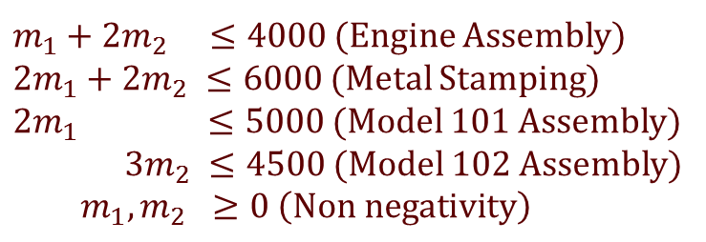
Building a Model
What is a solution to the problem? (What are you allowed to change?)
How much change will be tolerated?
How do you measure how good a solution is?
What is a “best” solution?
$\text{Maximize} C\left(m_{1},m_{2}\right)=3000m_{1}+5000m_{2}$
Decision variables
Constraints
$m_{1}+2m_{2} ≤4000$ (Engine Assembly)
$2m_{1}+2m_{2} ≤6000$ (Metal Stamping)
$2m_{1} ≤5000$ (Model 101 Assembly)
$3m_{2} ≤4500$ (Model 102 Assembly)
$$m_{1}, m_{2} ≥0 \left(Non negativity\right)$$
Objective function
Objective

Slide 13
Building a Model
What is a solution to the problem? (What are you allowed to change?)
How much change will be tolerated?
How do you measure how good a solution is?
What is a “best” solution?
$\text{Maximize} C\left(m_{1},m_{2}\right)=3000m_{1}+5000m_{2}$
Decision variables
Model to communicate to a solution process
Subject to
Constraints
$m_{1}+2m_{2} ≤4000$ (Engine Assembly)
$2m_{1}+2m_{2} ≤6000$ (Metal Stamping)
$2m_{1} ≤5000$ (Model 101 Assembly)
$3m_{2} ≤4500$ (Model 102 Assembly)
$$m_{1}, m_{2} ≥0 \left(Non negativity\right)$$
Objective function
Objective

Slide 14
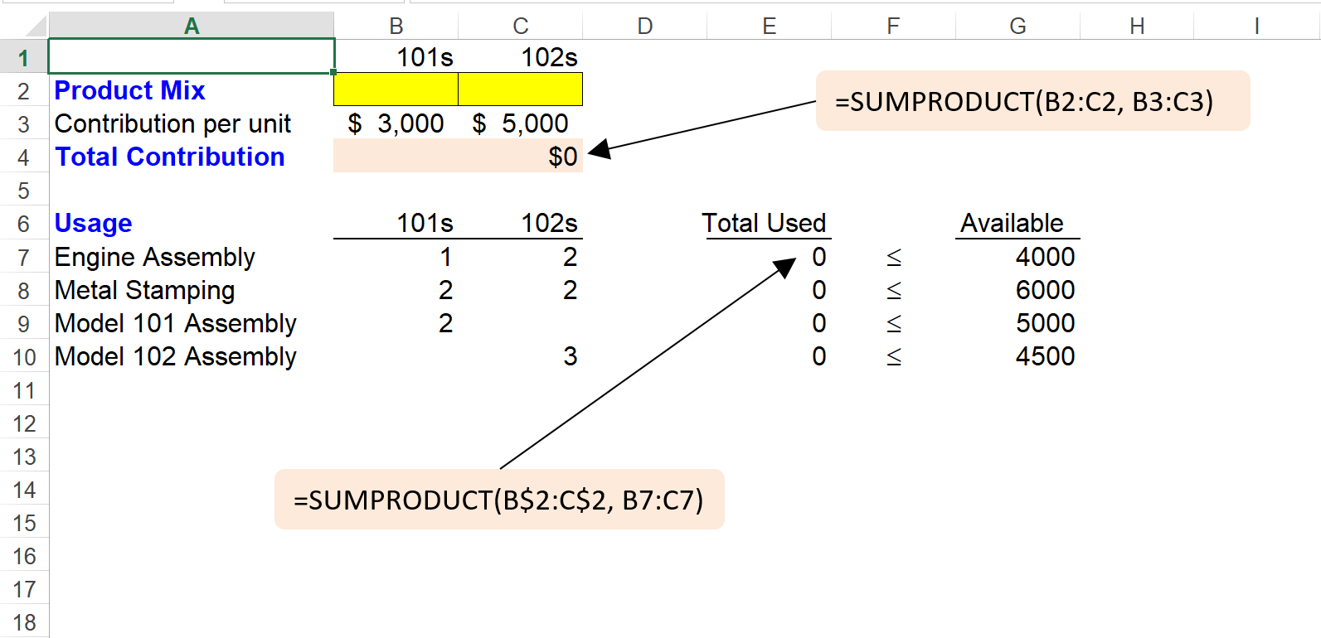
Solving with Microsoft Excel

Slide 15
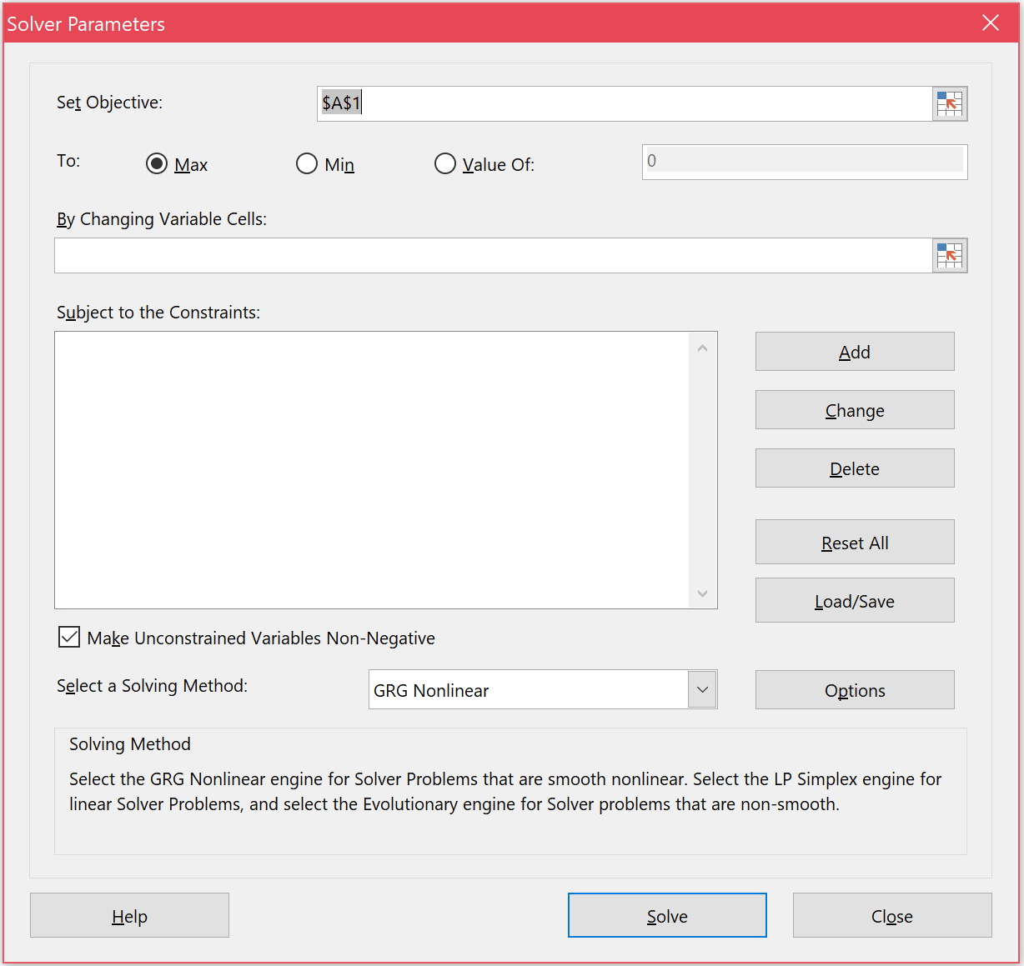
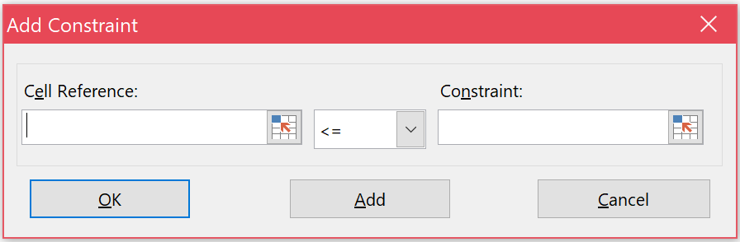
Solving with Microsoft Excel
What you want to do to the objective function
Address you stored the objective function in
Click here to add constraints
All inclusive non-negativity constraints here
Address of your decision variables
Use the drop-down to change the solving method to
Simplex LP
Relation b/w the LHS and RHS
Click this button to solve the problem
Address of the LHS of the constraint
Address of the RHS of the constraint

Slide 16
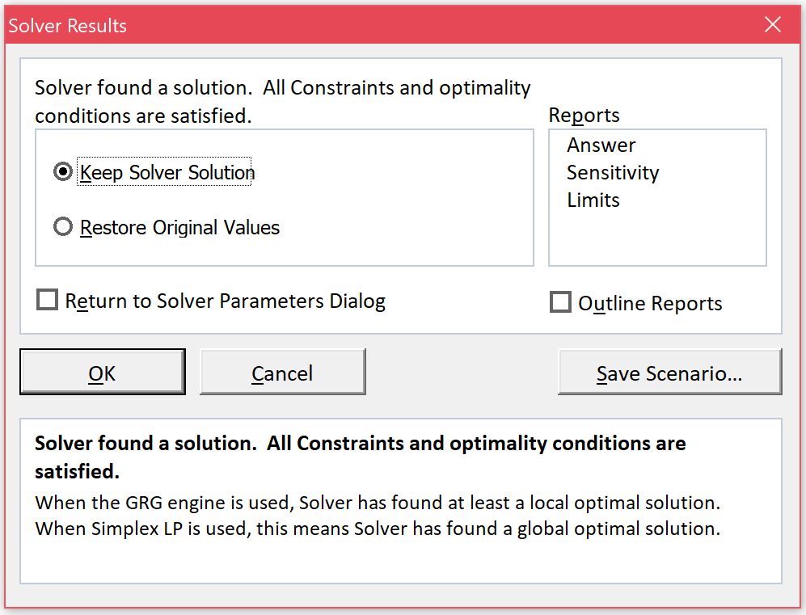
Solving with Microsoft Excel
Click OK to finish the process
But what if the solution process got into some trouble?

Slide 17
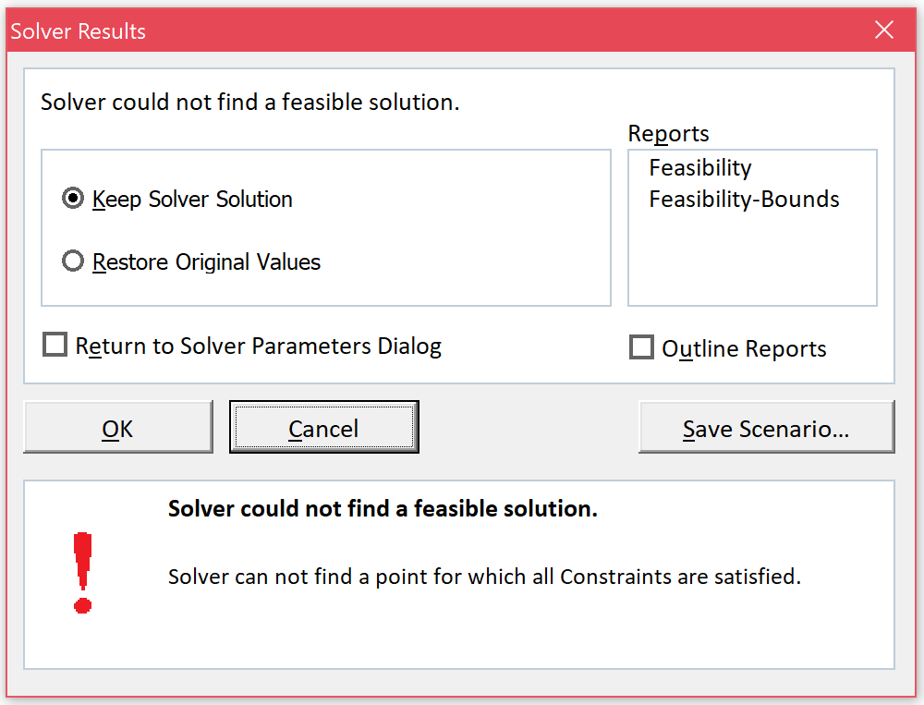
Solving with Microsoft Excel
If Solver could not find a feasible solution, then any value in any of the cells corresponding to decision variables have NO meaning.

